Slide 1
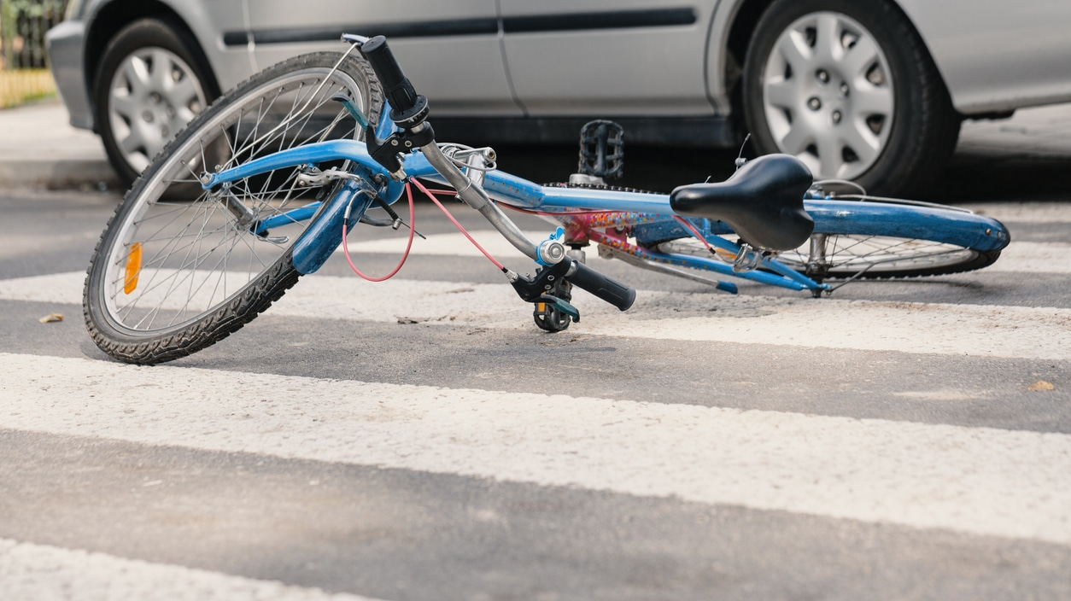
Predicting Severity of Cycling-related Collisions Decision Tree & Logistic Regression
Thomas Bok

Slide 2
Introduction
Purpose
To reduce the frequency of bicycle-related collisions in a community, an algorithm will be developed to predict the severity of collisions involving cyclists based on environmental factors, such as road condition, light condition, weather and accident location (intersection or block). This insight can serve to increase awareness of collisions in both cyclists and drivers under different conditions.
Machine Learning Method
Because the predictor, SEVERITYCODE is either a 1 (property damage only) and 2 (involving injury), and three attributes have been selected in the model, the choice of machine learning algorithm will be Decision Tree and Logistic Regression.

Slide 3
Scope of Data
Cyling-related collisions only:
ST_COLCODE (collision code) = 45 (cyclist)
Attributes to include:
ADDTYPE (address type)
LIGHTCON (light condition)
ROADCON (road condition)
WEATHER
Predictor:
SEVERITYCODE

Slide 4
Method
194673 records
Full data set
4701 records
Collisions involving cyclists only
4687 records
NaN dropped
4185 records
Removed records with values of low frequency
1. Isolating relevant data

Slide 5
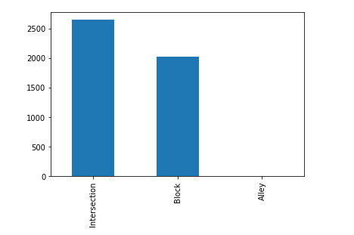
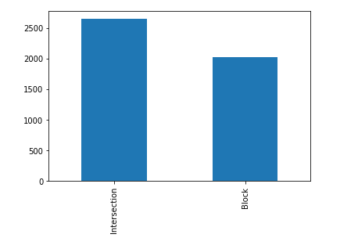
2. Removing records with values of low frequency Severe over or under-representation of a value for an attribute would hinder predictive accuracy of the model.
Address Type
Before
After

Slide 6
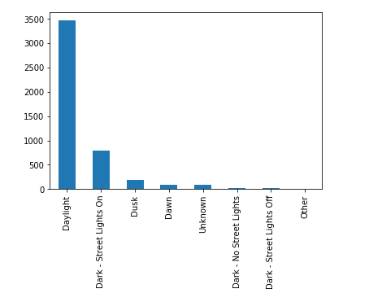
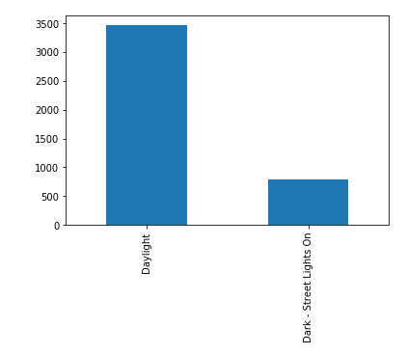
Light Condition
Before
After

Slide 7
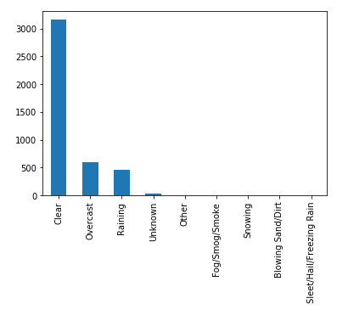
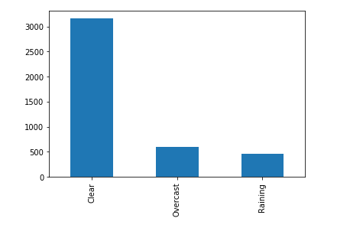
Weather
Before
After

Slide 8
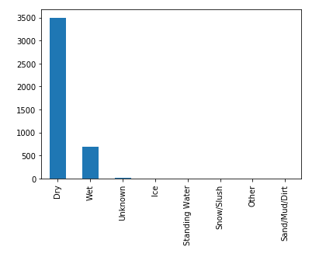
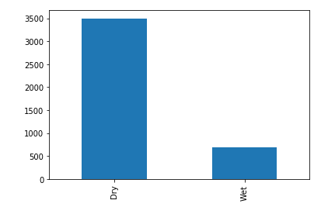
Road Condition
Before
After

Slide 9
3. Upsampling to balance dataset
Imbalance of the predictor, SEVERITYCODE was also identified. There were 3702 records with SEVERITYCODE of 1, and 483 records with 2, which means there were 7.6 times more records with SEVREITYCODE of 1 than those with 2.
To balance this dataset, the resample module from sklearn.util was used. In this case, upsampling was used to increase the numbre of records with SEVERITYCODE of 2 to 3702, thus bringing the total number of records to 7404.
Finally, the entire dataframe is converted to string and reindexed.

Slide 10
4. Algorithm settings
For the Decision tree, entropy was used as the criterion and because there were only 4 attributes, the maximum tree depth was set as default.
For the logistic regression, large linear classification (liblinear) was used

Slide 11
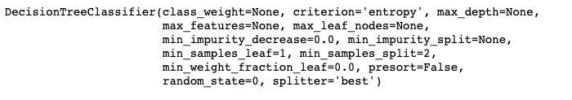
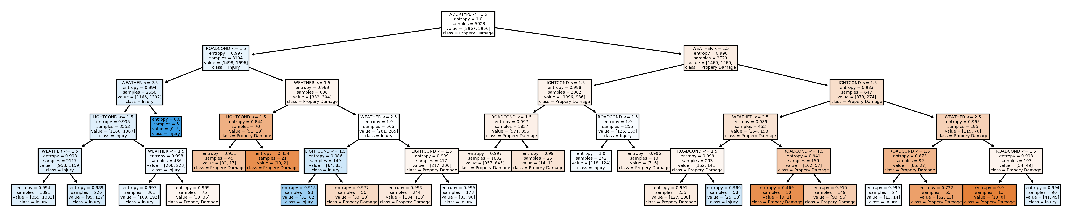
Result
Decision Tree

Slide 12
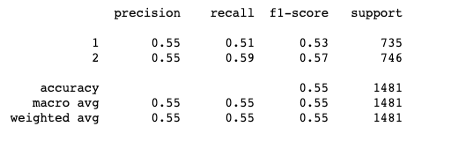
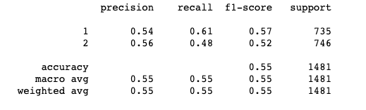
Performance Evaluation
According to the F1-score, the decision tree predicted SEVERITYCODE of 1 and 2 53% and 57% of the time, respectively, with an average accuracy of 55%. Meanwhile, the logistic regression model predicted SEVERITYCODE of 1 and 2 57% and 52% of the time, respectively, with an average accuracy of 55%.
Decision Tree
Logistic Regression
The Jaccard similaity score for the decision tree and Logistic regression were 0.5503 and 0.5483.

Slide 13
Discussion
Low predictive Accuracy
The predictive accuracy of both models were quite low at 55%. Changing the hypreparametr (c) fo the logistic regression and changing the maximum tree depth did not drastically improve the accuracy.
Confounding variables not accounted for
Variables (causes) that can alter the 2 severity types not that were not accounted by this model. In other words, the severity of accidents occurred mostly by chance given the environmental factors used in this model. In the original data set, driver characteristics such as unattentiveness and driving under the influence were available. These attributes would be relevant in the outcome of an accident. However, for the purpose of this analysis, only environmental factors were of interest. Perhaps a more comprehensive model including more attributes would result in a higher predictive accuracy.
Interpretability of Decision Tree interpretability
Reducing the number of low frequency values for the attributes led to a decision tree with 5 levels, making it easier to interpret.

Slide 14
Conclusion
This analysis demonstrated that light condition, road condition, weather and location of accident can only predict the severity of an accident 55% of the time. Human factors such as driver inattentiveness and driving under the influence would also alter the severity of an accident. The take home message of this analysis is that for cyclists and drivers to understand that accidents invovling cyclists are interactions of both their environment and driving behavior. One might not be able to avoid driving or cycling in averse environments all the time, but cyclists and drivers can always be more attentive on the road all the time.

